Slide 1
Anomaly Detection Using Time Series Data
Varsha Kumbhar

Slide 2
Data Cleaning
The original data set : 377719(rows)X7(Columns along with time stamp)
Data recorded every 5 minutes
Following data cleansing steps were used
Checked Duplicates
No duplicates were found
Checked For blanks
No blank values were found
Checked and removed records having values other than that of numeric type(Comm_fail, Configure, I/O Timeout, Not_Connect, Scan_Timeout, Unit_Down)
1595 such records were removed. This contributes to data loss of around 0.4%
After removing the above records missing dates from the dataset were computed
Records for following dates were not available
2017-01-11, 2017-10-04, 2017-10-05, 2017-10-12
Total number of missing records above dates contribute the the dataset = 573
Imputation for the missing records were not carried on as missing dates were only 0.15%of the whole data
All the above steps were carried out using python’s Pandas package
Final cleaned dataset consist of 376124 records

Slide 3
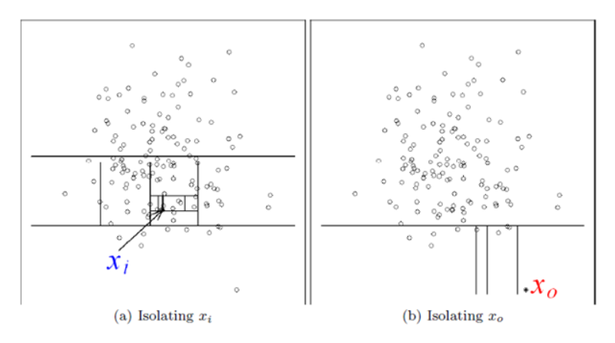
Isolation Forest
Isolation forest (IF) is unsupervised machine learning method used for anomaly detection that identifies anomalies using isolation
Like Random forest it is an ensemble of decision trees
IF algorithm is based on the principal that anomalies are observations that are few and different, which makes them easy to isolate
IF recursively partitions data, by selecting a random feature, then randomly selecting split value for the feature
Outliers need few partitions to be isolated as compared to normal data points
Thus, anomalies are the data points having smaller path length.
Saurabh Singh. Anomaly Detection Using Isolation Forest Algorithm @www.analytics-vidhya.com

Slide 4
Why Isolation Forests
IF is an unsupervised machine learning method i.e it does not require any labelled training data
Based on the assumption that malicious data are few and different as compared to normal data
It detects anomalies faster as compared to other anomaly detection techniques
Requires less memory

Slide 5
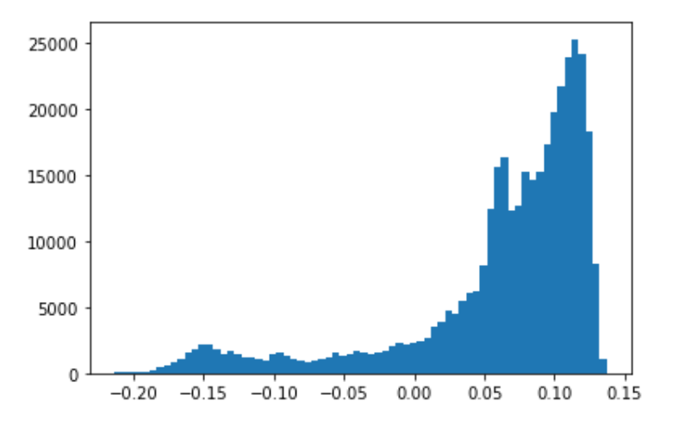
Method
IF from python package scikit-learn was used this project
Model was build using all other parameters as default and n_estimators was set to 500 and max_parameters was set to 6 (these values were obtained after optimizing the parameters)
To filter the outliers following steps were followed:
Decision function scores was obtained for each record
A threshold was set to decision function score of -0.2. This was done by plotting a histogram decision function score and observing the plot
All the records having decision function score values less than -0.2 were classified as outliers
Histogram of Decision function values

Slide 6
Insights
Our IF model classified 206 records as outliers (provided in the folder in outliers.xlsx file)
Looking at the outliers it can be said that there was some problem with the cyclone preheater on days ranging from 2nd August 2019 - 3rd August 2019 and then 15th September 2019 – 17th September 2019
Other instances where the cyclone preheated did not perform well is provided in outlier.xlsx file.

Slide 7
Thank you

